Slide 1
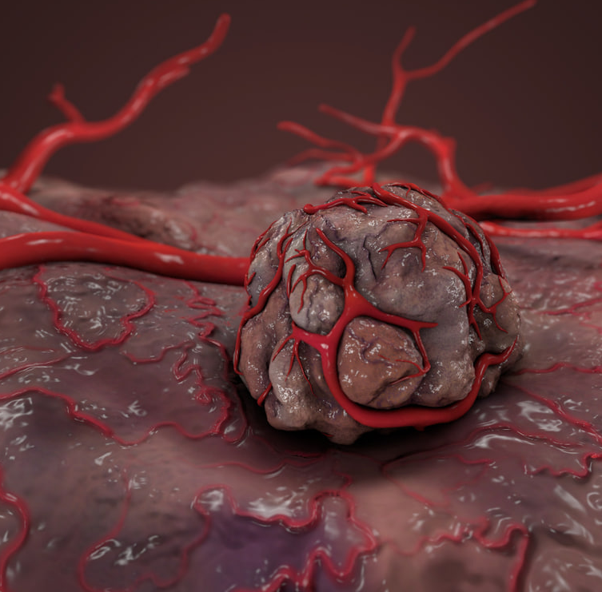
Arab Collaborative Hematology and Oncology Group (ACHOG)
Algerian society of training and research in Oncology (SAFRO)
Memorial Sloan Kettering Cancer Center NYC USA (MSKCC)
Naef K. Basile Cancer Institute of Beirut (NKBCI)
5th Course of Angiogenesis with Recent Advances in Immunotherapy
Accreditation Statement
This activity has been planned and implemented in accordance with the accreditation requirements and policies of the Accreditation Council for Continuing Medical Education (ACCME) through the joint providership of Memorial Sloan Kettering Cancer Center, SAFRO and the Basile Cancer Institute. Memorial Sloan Kettering Cancer Center is accredited by the Accreditation Council for Continuing Medical Education to provide continuing medical education for physicians.
AMA Credit Designation Statement
Memorial Sloan Kettering Cancer Center designates this live activity for a maximum of 10.25 AMA PRA Category 1 CreditsTM . Physicians should claim only the credit commensurate with the extent of their participation in the activity.
Course Directors:
Ghassan Abou-Alfa, MD, MBA
Memorial Sloan Kettering Cancer Center NYC USA
Adda Bounedjar, MD
Frantz Fanon Hospital – Blida 1 University , Algeria
Ali Shamseddine, MD, FRCP
American University of Beirut
will be granted
from MSKCC
CME
February 15 - 16, 2019 El Djazair Hotel; Algiers Algeria
PROGRAM

Slide 2
Day 1: 15th February 2018
12h15 – 13h45 | Lunch
14h00 - 14h10 | Introduction A. Bounedjar – S. Khatib – G. Abou Alfa – K. Bouzid
Moderators: G.Abou Alfa – H. Mahfouf
14h10 - 14:35 | Basis of Angiogenesis Arash Rafi, MD (Cornell)
14h35 - 14h50 | Predictive and Prognostic Markers, Mechanisms of resistance in angiogenesis markers Lucas Treps, PhD (Belgium)
14h50 - 15:15 | Imaging the Era of Anti-Angiogenics and checkpoint inhibitors Darragh Halpenny ,MD (MSKCC)
15h15 - 15:40 | Safety of Antiangiogenic Therapy Ali Shamseddine, MD (AUB)
15h40 - 16h05 | Gastric Cancer David Ilson, MD (MSKCC)
16h05 - 16h25 | Coffee –Break
Moderators: A. Shamseddine – B. Larbaoui
16h25 - 16h50 | Neuroendocrine Tumors Eileen O’Reilly, MD (MSKCC)
16h50 - 17h15 | Colon Cancer Sally Temraz,MD (AUB)
17h15 - 17h40 | Renal Cell Carcinoma Debbie Mukherji (AUB)
17h40 - 18h05 | Gynecological Malignancies (Ovary and Cervix) Hisham Al Ghazali ,MD (Egypt)
18h05 - 18h30 | Lung Cancer Greg Riely, MD (MSK)
20h00 | Dinner
Day 2 : 16th February 2019
Moderators: G. Abou Alfa – M. Oukkal
09h00 - 09h25 | Basis of Immunology and Immunotherapy Taha Merghoub, PhD (MSKCC)
09H25 – 09h50 | Anti-Tumor Immune Responses and Immunotherapy Karen Willard-Gallo, MD, PhD (Belgium)
09h50 - 10h15 | Predictive Biomarkers of Checkpoint Inhibitors : Challenges and Perspectives of the Pathologist Patrick Pauwels, MD, PhD (Belgium)
10h15 - 10h40 | MSI-H and Chekpoints Inhibitors Taha Merghoub, PhD (MSKCC)
10h40 - 11h00 | Coffee Break
Moderators: A. Shamssedine – H. Al Ghazali
11h00 - 11h25 | Hepatocellular Carcinoma: From Angiogenesis to Immunotherapy Ghassan Abou-Alfa, MD, MBA (MSKCC)
11h25 - 11h50 | Check Point Inhibitors in Lung Cancer Greg Riely,MD (MSKCC)
11h50 - 12h15 | Check Point Inhibitors in Urothelial Malignancies Debbie Mukherji (AUB)
12h15 - 12h40 | Radiation Therapy and Abscopal Effect Chris Crane (MSKCC)
12h40 - 13h05 | Immune-Related Adverse Events and their Management Azeez Farooki, MD (MSKCC)
13h05 - 13h15 | Clossing A. Bounedjar – G. Abou Alfa
13h15 | Lunch Break

